Slide 1
32nd Annual Workshop of the EuroMemo Group
10 - 12 September 2026
Oxford Brookes University
The implications of strengthening the international role of the Euro
Marica Frangakis
Independent Researcher
Notes:
Million-dollar question - an important or difficult question which people do not know the answer to (836.750 Euro, 24/9/2017)

Slide 2
Outline
The Euro – A mixed record; The international position of the Euro
The Trump effect – Euro appreciation
Dedollarisation – A gradual process
Modest currency realignment - US$ resilience
Strengthening the international role of the euro
  The EU narrative
  The EU strategy
When reality does not fit the theory - The EU does not fulfill the requirements for a strong euro
The Spanish proposal for EU joint debt
The costs of an internationally strong currency
The European Parliament’s change of heart 2020-2026
A contestation that goes beyond currency internationalization
Prospects and Alternatives

Slide 3
The Euro – A mixed record
Progress in the euro’s internationalization has been mixed — falling short of optimists’ hopes of dethroning the dollar while exceeding skeptics’ predictions of failure (Eichengreen, 2026).
Essentially a regional currency rather than a global one; of the countries using the euro as an exchange rate anchor and as an invoicing currency for global trade, none is located outside Europe or Africa (Ilzetzki et al, 2026)
But, number of countries adopting the euro nearly doubled (1999:11 to 2026:21); Resilient as an official reserve currency (stable share 1999-2025); Important as currency for invoicing global exports supported by Euro area’s strong position as a trading hub

Slide 4
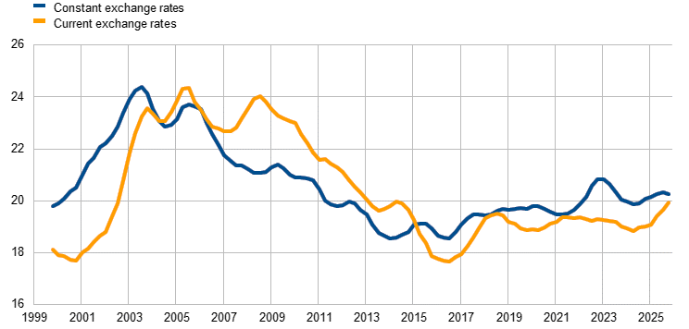
Composite index of the international position of the euro (arithmetic average of the share of the euro in a broad range of indicators; percentages; at current & constant Q4 2025 exchange rates)
Notes:
Sources: Bank for International Settlements (BIS), International Monetary Fund (IMF), CLS Bank International, Ilzetzki, Reinhart and Rogoff (2019) and ECB staff calculations

Slide 5
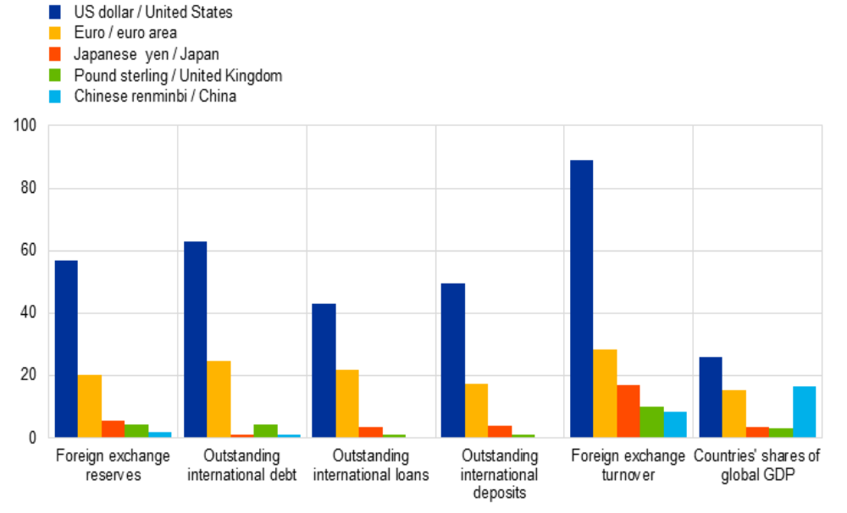
Snapshot of the international monetary system and countries’ shares of global GDP 2025 (%)

Slide 6
Snapshot of the international monetary system and countries’ shares of global GDP 2025 (%)
Currency/Region | Foreign exchange reserves | Outstanding international debt | Outstanding international loans | Outstanding international deposits | Foreign exchange turnover | Countries' shares of global GDP
US dollar / United States | 56,77 | 63,10 | 42,99 | 49,74 | 89,08 | 26,04
Euro / euro area | 20,25 | 24,64 | 21,74 | 17,26 | 28,54 | 15,23
Japanese yen / Japan | 5,78 | 1,34 | 3,72 | 4,07 | 16,91 | 3,75
Pound sterling / United Kingdom | 4,41 | 4,47 | 1,26 | 1,36 | 10,16 | 3,39
Chinese renminbi / China | 1,95 | 1,02 |  |  | 8,60 | 16,61
Notes:
Ecb.ire.202606_chartdata.en.xls

Slide 7
The Trump effect
‘Liberation Day’ Tariffs, April 2025 – Heightened uncertainty about the stability of US current and future policies
President Trump’s administration raised questions about rule of law, separation of powers, checks on executive power in US and monetary policy (Fed independence)
Alliance politics –Reduced commitment to NATO (security guarantee extended by US); tensions over Greenland affair; weaponizing tariffs; repeated threats against long-standing allies influence reserve currency status
Alliance partners hold dollar reserves on basis of good faith/trust, thus supporting global role of US dollar. Doubts over US policy have adverse effect.
Notes:
Sweeping tariffs on nearly all trading partners; overturned by US High Court later, but impact was real.

Slide 8
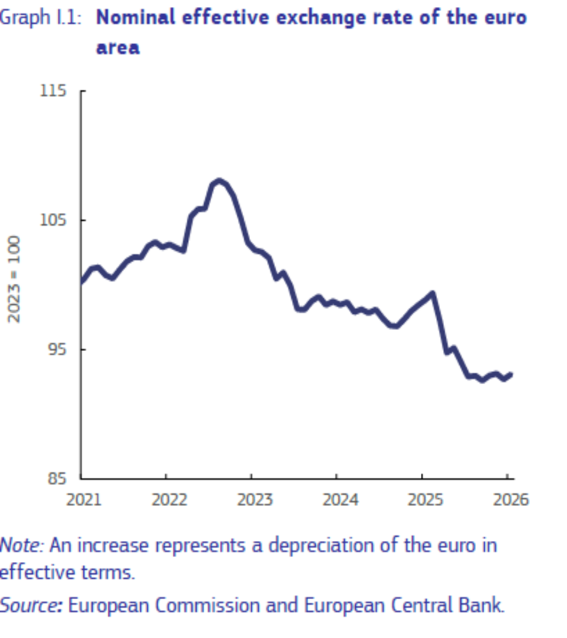
2025: Euro appreciation (2023=100)
“Much of the euro’s appreciation in this period reflected a broad-based weakness of the US dollar rather than the euro’s strength per se. The scale of the dollar’s depreciation points to the influence of a perceived increase in the riskiness of US assets due to heightened economic policy uncertainty in the US.
Starting on 19 January 2026 there was an episode of euro appreciation following the US administration announcement that it would levy extra tariffs on NATO allies in relation to Greenland and there was a further weakening of the euro against the US dollar following the start of the military campaign by the US and Israel against Iran.” (Quarterly Rep. in the Euro Area, Vol.25, No.1, April 2026)
Notes:
In 2025, the euro experienced a significant appreciation (Graph I.1). From its trough in February 2025, the euro’s nominal effective exchange rate (NEER) strengthened by 7.3% until December 2025. This appreciation was largely driven by gains against the US dollar (12.5%) and the Chinese renminbi (8.9%).

Slide 9
Dedollarisation – A gradual process
Dedollarization - Deliberate effort by nations, financial institu­tions & regional blocs to lessen their dependence on US dol­lar in trade, reserve management & cross-border finance. Motivated by geopo­litical tension, increasing use of the dollar as a policy instrument & structural innovation in payments and settlement technology (P.C.Earle, 2026)
Dominance of dollar gradually being eroded. E.g. the freezing of Russian foreign-exchange reserves in 2022 and the exclusion of certain banks from the SWIFT payment-processing network convinced many governments that reserve safety is contingent on political alignment with Washington
Emergence of central-bank digital currencies, bilateral swap lines & commodity-linked settlement arrangements have lowered the tech­nical and transactional barriers to non-dollar trade

Slide 10
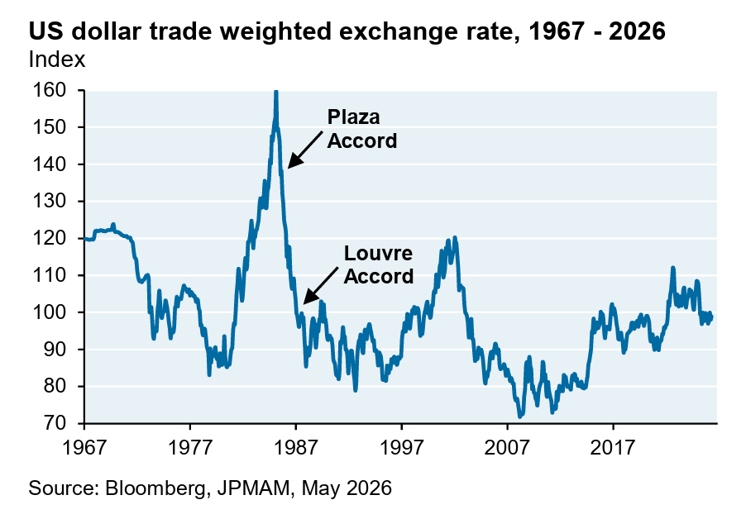
Modest currency realignment - US$ resilience (annual NEER - weighted ave. of bilateral e-rate main trading partners)
Notes:
Other than an immediate selloff of ~10% when Trump took office (from a post-GFC high level for the dollar), the trade-weighted dollar has been resilient. This 10% decline looks like a modest currency realignment rather than the onset of a sharper decline that took place in the 1980’s (after the Plaza Accord to deliberately weaken the dollar), or the decline in the early 2000’s after the launch of the Euro.

Slide 11
Strengthening the international role of the euro - The EU narrative
P. Cipollone (ECB) - “The euro’s international use has grown in recent years, but largely by circumstance rather than by design. In a more contested global monetary system, Europe needs to act deliberately to strengthen the role of its currency”
European Council - Benefits of a strong euro in the world – “Increased resilience of the international monetary system; A strong Euro reduces dependence on other currencies; better protects the EU economy from foreign exchange shocks; opens up more choices for market operators and gives more autonomy to EU consumers; ensures lower transaction, financing and risk management costs for businesses; allows for more reliable access to finance for EU businesses and governments.
…. underpinned by the pursuit of sound economic policies in the euro area and ongoing efforts to complete the economic and monetary union, the banking union and the capital markets union”.

Slide 12
The EU strategy for a strong euro
On 19 January 2021, the Eur. Commission presented a strategy for better preparing the EU's economic and financial system for the future - Strengthening the international role of the euro is one of the three main pillars of the strategy, alongside developing more resilient financial market infrastructure and improving the implementation of EU sanctions regimes.
On 26 June 2025, the EU leaders invited the Council, the Commission and the European Central Bank to take work forward to reinforce the international role of the euro, as both a reserve currency and a transaction currency.
Chr. Lagarde: “Completing the Single Market remains essential to unlocking Europe’s full potential. Moreover, for the euro to evolve into a truly global international currency, the euro area must build scale and deeper, more liquid capital markets. Therefore, we must integrate and deepen our capital markets, taking concrete steps towards completing the savings and investments union. Additional steps like joint financing of public goods would help establish a safe and liquid pool of EU public debt”

Slide 13
When reality does not fit the theory - The EU does not fulfill the requirements for a strong euro
Requirements
Strong underlying economy
Policy co-ordination: economic, fiscal, monetary
Broadening International trade relations
Risk-sharing amongst EU member states for ‘safe’, risk-free euro: common issuance
Integrated financial markets: harmonizing supervision, insolvency law, securities regulation, taxation
Geopolitical profile of issuer: clearer, more unified security policy by EU member states for long-term reliability of euro
Inherent gaps and contradictions
Underlying economy - Economic fundamentals vary greatly across member states
Policy coordination – Trial and error; e.g. fiscal governance framework; ECB and the GFC; social policy subsumed under economic policy objectives
International trade agreements –Long gestation period
Risk-sharing: Germany and other ‘frugal’ states opposed; Spanish proposal for joint debt
Integrated financial markets – Resistance by national bodies
Geopolitical profile – Emphasis on militarization; fragmentation

Slide 14
The Spanish proposal – EU joint debt
The EU first joint debt - 750 billion euro - launched in 2021 (Covid pandemic)
Spain has proposed joint debt of 5 trillion euro to replace 25% of GDP in national debt – swapping national debt for EU debt & refinancing maturities, not increasing aggregate indebtedness - to finance public goods (defense, climate, digitalization); estimated savings on borrowing costs (leveraging Eur.Comm’s AAA credit rating) euro 25 bn pa
Membership voluntary: European Sovereign Facility; member states must abide by fiscal rules
European ‘safe asset’ – Enhancing liquidity of Euro; capital market integration
Linked to debate on next 2028-2034 budget if Eurobonds backed by new EU revenues; Own resources decisions require unanimity and ratification by national parliaments

Slide 15
The Spanish proposal – A non-starter?
Proposal at a political & exploratory phase in the Eurozone and Eur. Council
Although membership voluntary, participation of 5 largest issuers – Germany, France, Italy, Spain, Netherlands – necessary for scheme to take off
S. Europeans, led by Spain and France, support the scheme.
N. Europeans, led by Germany & Netherlands, oppose it –they can borrow at a lower cost than the Eur. Comm. i.e. nothing to gain; concerns over ‘moral hazard’
ECB supports joint issuance
Lagarde: “Pretty obvious we need to have a European asset with can parallel with US treasury bonds; how we go about it to be decided” (9/7/2026 interview)

Slide 16
Costs of an internationally strong currency
The EU strategy for a strong euro is eclectic; it ignores the connection between the international and national/domestic requirements and the adjustments that are necessary
The EU narrative focuses on the possible benefits of strengthening the euro. It ignores the costs of supporting a global currency, such as:
  currency overvaluation
  external constraints on policy
  dangers from capital flow volatility
  blurred signals from monetary aggregates
  lower effects of monetary policy on import prices
  increased international responsibilities
The net gain of becoming a reserve currency is not self-evident – Costs may outweigh benefits. (Martin, A. 2020)

Slide 17
The European Parliament’s change of heart
Eur. Parl. 2020 – A sceptical view: ‘International currency status is not necessarily a binary variable but can be a matter of degree. A currency can be of different international importance to private and public users along different roles and functions – a currency does not have to be equally important as an international medium of exchange, unit of account, and store of value, respectively’
2021 – Change of heart – ‘It is in the strategic long-term interest of the euro area and of its Member States to draw all possible benefits from issuing the euro currency, and in particular from its strengthened international role’
2026 - ‘A stronger global role for the euro will not emerge through market forces alone, but requires a coherent strategy by which public authorities establish the conditions for its wider use; … the US and China are actively pursuing such strategies in support of their currencies’

Slide 18
A contestation that goes beyond currency internationalisation
Technical conditions matter, but not enough to understand currency internationalisation
Political economy of currency internationalization – Must take account of the necessary domestic adjustments: ‘social trade-offs among competing domestic claims on finite public resources in a sustainable manner’ (Germain & Schwartz, 2017)
E.g. generating/sustaining global demand so as to put currency into circulation on global markets on a net basis through an excess of imports or by lending – i.e., a current account deficit. The means for providing global demand include financial intermediation and generation of financial assets
Competition from imports may hurt jobs and businesses - Social trade-off: increased unemployment & inequality as financial sector grows to service demands of currency internationalization

Slide 19
Prospects and alternatives
Adam Tooze - ‘the quality of a currency system is ultimately defined by the class relations that underpin it’
US &‘Profit dollar’: ‘a promise of liquidity and a vehicle for outsized and unfettered capital accumulation’ - ‘If in the era of Bretton Woods 2.0 (2000-2015) official (mainly China) reserve accumulation covered America’s balance of payments imbalance, it is now inflows of funds into US private assets, attracted by the dramatic dominance of American financial markets over all possible competitors’
Euro - Shifting balance of class forces, increasing inequality, rise of extreme Right wing politics will intensify pressure for strengthening the international role of Euro despite adjustment costs/lack of necessary conditions
Eur. Parl. - ‘International currency status is not necessarily a binary variable but can be a matter of degree’ - (Eur.Parl. 2020)

